Slide 1

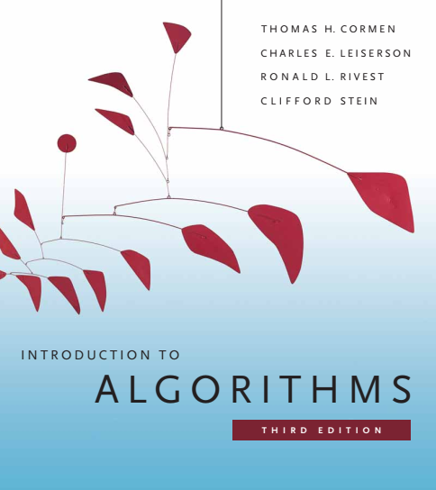
Design and Analysis of Algorithms
Dr. Sajid Iqbal
sajidiqbal.pk@gmail.com
Reference Book
Introduction to Algorithms 3rd Edition By Thomas H. Cormen et. al.
https://mitpress.mit.edu/books/introduction-algorithms-third-edition
COMEDXD

Slide 2
Binary Search Trees
Chapter 12: Binary search trees

Slide 3

Background
The search tree data structure supports many dynamic-set operations
SEARCH, MINIMUM, MAXIMUM, PREDECESSOR, SUCCESSOR, INSERT, DELETE
A search tree can be used as a dictionary and as a priority queue
Basic operations on a binary search tree take time proportional to the height of the tree i.e. $O(\log\left(n\right))=O(h)$
Worst case time may be $O(n)$ if a tree is linear list of nodes.

Slide 4

Introduction
A binary search tree is organized as binary tree
Usually a tree is implemented using Linked list data structure
Binary-search-tree (BST) property
Let root is a node in BST and left & right are its left and right children
$root.key≥left.key$ and $left.key≤right.key$
Tree traversing: it is the process of reading a tree
Pre-order traversing
In-order traversing
Post-order traversing
In order traversing allows us to print values in sorted order
Key
Left | Parent | right
6
5
7
2
5
7
8

Slide 5

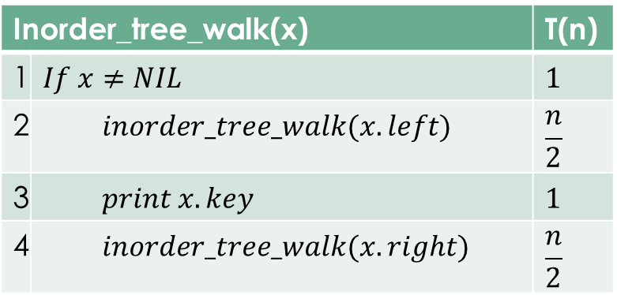
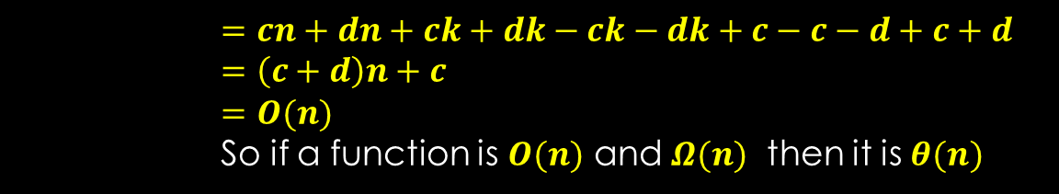
BST Traversing
Theorem 12.1
If $x$ is root of n-node tree then in order walk takes $θ(n)$ time
Proof
Since Traversing visits all nodes so $Ω(n)$ time is taken
Let left sub-tree has $k$ nodes so right sub-tree will have $n−k−1$ nodes
$T\left(n\right)≤T\left(k\right)+T\left(n−k−1\right)+d$
For $n=0$
$T\left(n\right)≤T\left(k\right)+T\left(n−k−1\right)+d=0+0+d=d$
For $n>1$
$T\left(n\right)≤T\left(k\right)+T\left(n−k−1\right)+d$
$=\left[\left(c+d\right)k+c\right]+\left[\left(c+d\right)\left(n−k−1\right)+c]\right)+d$
$=\left[ck+dk+c\right]+\left[cn−ck−c+dn−dk−d+c\right]+d$
Inorder_tree_walk(x) |  | T(n)
1 | $$If x≠NIL$$ | $$1$$
2 | $$inorder_tree_walk(x.left)$$ | $$\frac{n}{2}$$
3 | $$print x.key$$ | $$1$$
4 | $$inorder_tree_walk(x.right)$$ | $$\frac{n}{2}$$
$$=cn+dn+ck+dk−ck−dk+c−c−d+c+d$$
$$=\left(c+d\right)n+c$$
$$=O(n)$$
So if a function is $O(n)$ and $Ω(n)$ then it is $θ(n)$

Slide 6
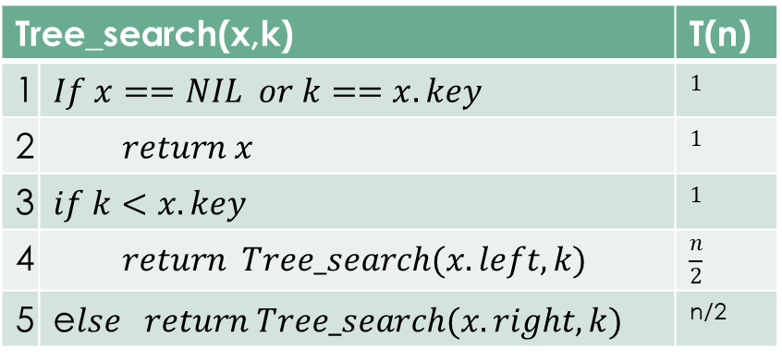
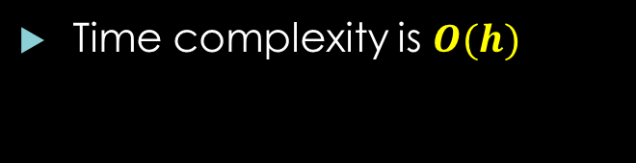
Search in BST
Tree_search(x,k) |  | T(n)
1 | $$If x==NIL or k==x.key$$ | $$1$$
2 | $$return x$$ | $$1$$
3 | $$if k<x.key$$ | $$1$$
4 | $$return Tree_search(x.left,k)$$ | $$\frac{n}{2}$$
5 | e$lse return Tree_search(x.right,k)$ | n/2
15
6
18
3
7
17
20
2
4
13
Time complexity is $O(h)$
9

Slide 7
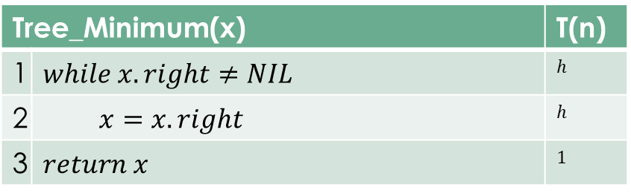
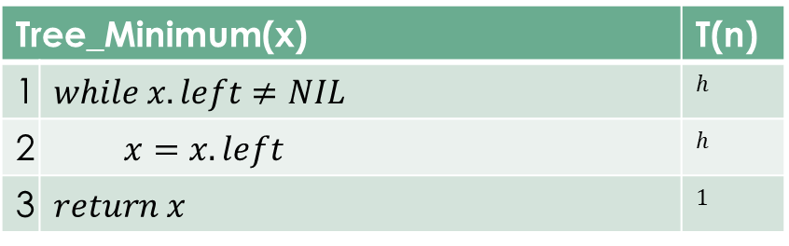
Minimum and Maximum
Tree_Minimum(x) |  | T(n)
1 | $$while x.left≠NIL$$ | $$h$$
2 | $$x=x.left$$ | $$h$$
3 | $$return x$$ | $$1$$
15
6
18
3
7
17
20
Tree_Minimum(x) |  | T(n)
1 | $$while x.right≠NIL$$ | $$h$$
2 | $$x=x.right$$ | $$h$$
3 | $$return x$$ | $$1$$
2
4
13
9

Slide 8
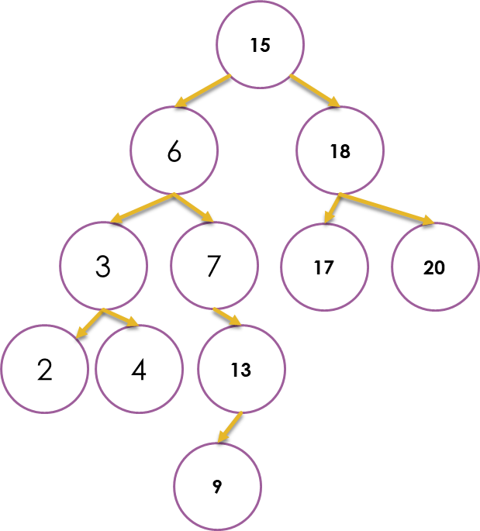
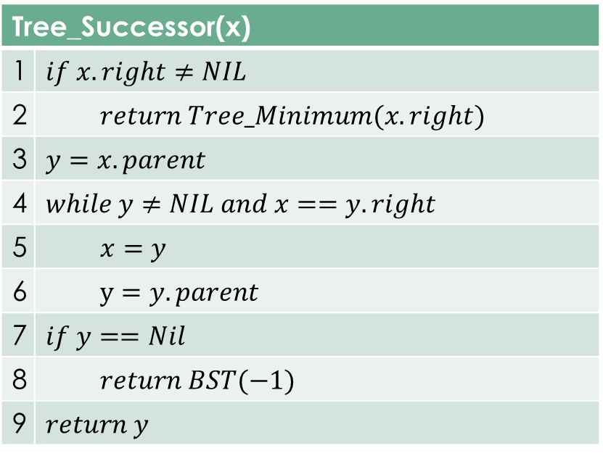
Successor
An element that comes after x in sorted order
Tree_Successor(x)
1 | $$if x.right≠NIL$$
2 | $$return Tree_Minimum(x.right)$$
3 | $$y=x.parent$$
4 | $$while y≠NIL and x==y.right$$
5 | $$x=y$$
6 | $$y=y.parent$$
7 | $$if y==Nil$$
8 | $$return BST(−1)$$
9 | $$return y$$

Slide 9
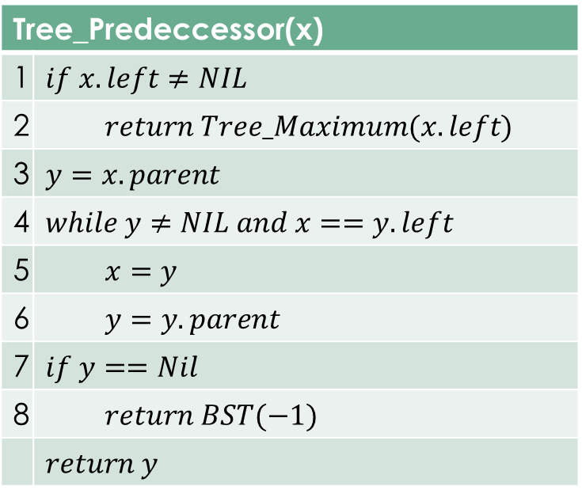
Predecessor
Maximum value before current value when in sorted order
Maximum value in left subtree
Tree_Predeccessor(x)
1 | $$if x.left≠NIL$$
2 | $$return Tree_Maximum(x.left)$$
3 | $$y=x.parent$$
4 | $$while y≠NIL and x==y.left$$
5 | $$x=y$$
6 | $$y=y.parent$$
7 | $$if y==Nil$$
8 | $$return BST(−1)$$
 | $$return y$$

Slide 10



Thanks for watching
Dr. Sajid Iqbal
Assistant Professor
Department of Computer Science
Bahauddin Zakariya University, Multan
sajidiqbal.pk@gmail.com
https://github.com/sajjo79/Design_and_Analysis_of_Algorithms
COMEDXD
Allah Hafiz

